Slide 1
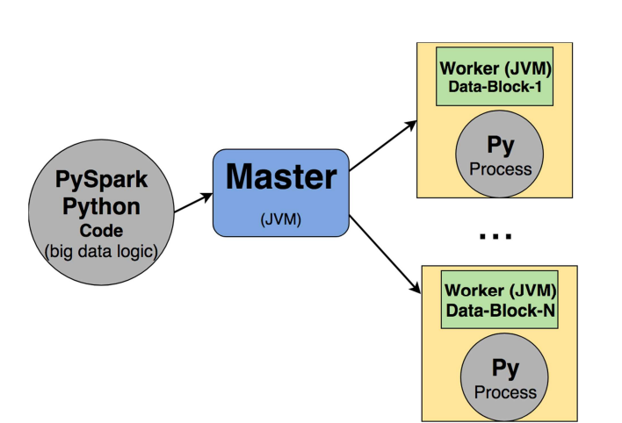
PySpark Architecture

Slide 2
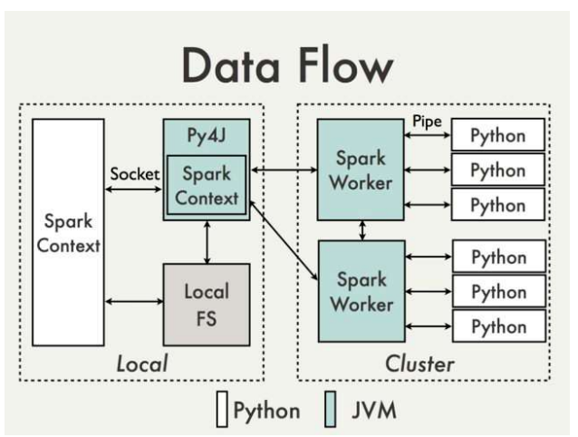
PySpark Data Flow
In the Python driver program (which is your Spark application in Python), SparkContext uses Py4J software — A Bridge between Python and Java to launch a JVM and create a JavaSparkContext.
Py4J is only used on the driver for local communication between the Python and Java SparkContext objects; large data transfers are performed through a different mechanism.
RDD transformations in Python are mapped to transformations on PythonRDD objects in Java.
On remote worker machines, PythonRDD objects launch Python subprocesses and communicate with them using pipes, sending the user’s code and the data to be processed.
SparkContext uses Py4J software, which enables Python programs running in a Python interpreter to dynamically access Java objects in a JVM. Methods are called as if the Java objects resided in the Python interpreter and Java collections can be accessed through standard Python collection methods. Py4J also enables Java programs to call back Python objects.

Slide 3
RDD Example
RDD stands for Resilient Distributed Dataset. It is considered the backbone of Apache Spark. This is available since the beginning of the Spark. That’s why it is considered as a fundamental data structure of Apache Spark. Data structures in the newer version of Sparks such as datasets and data frames are built on the top of RDD. In Spark, anything you do will go around RDD. The dataset in Spark RDDs is divided into logical partitions. If the data is logically partitioned within RDD, it is possible to send different pieces of data across different nodes of the cluster for distributed computing. RDD helps Spark to achieve efficient data processing.
Features:
Immutability
In-memory computation
Lazy evaluation
Fault-tolerant

Slide 4
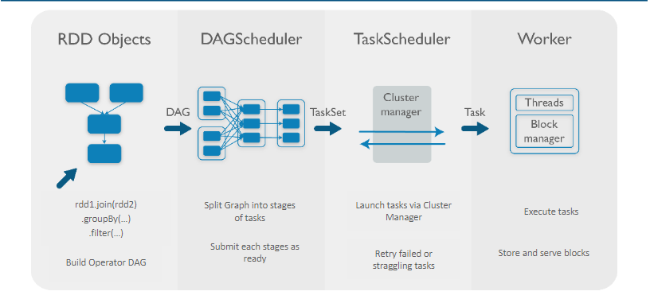
RDD Workflow

Slide 5
Shuffle
Shuffling is a process of redistributing data across partitions that may or may not cause moving data across JVM processes or even over the wire (between executors on separate servers).
Shuffling is the process of data transfer between stages (to be explained shortly).
According to Spark documentation, RDD operations are compiled into a DAG (directed acyclic graph) of RDD objects, where each RDD points to the parent it depends on (illustrated as Figure 6.4). At shuffle boundaries, the DAG is partitioned into so-called stages (Stage-1, Stage-2, …) that are going to be executed in order. Since shuffling involves copying data across executors and servers, making the shuffle is a complex and costly operation. Since shuffling is a costly operation, we have to be careful in selecting proper reductions.

Slide 6
How to create RDD?
Parallelize method by which already existing collection can be used in the driver program.
By referencing a dataset that is present in an external storage system such as HDFS, HBase.
New RDDs can be created from an existing RDD.

Slide 7
Operations on RDD
Transformations - Transformations are the processes that you perform on an RDD to get a result which is also an RDD. The example would be applying functions such as filter(), union(), map(), flatMap(), distinct(), mapPartitions(), sortBy() that would create an another resultant RDD. Lazy evaluation is applied in the creation of RDD.
Actions - Actions return results to the driver program or write it in a storage and kick off a computation. Some examples are count(), first(), collect(), take(), countByKey(), collectAsMap(), and reduce().
Transformations will always return RDD whereas actions return some other data type.

Slide 8
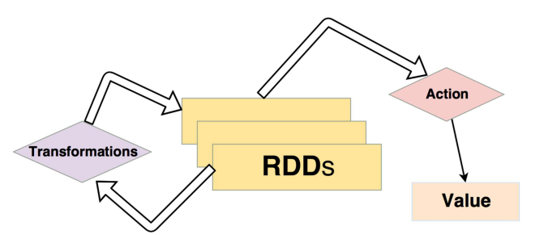
Transformations and Actions
Transformations:
Distinct
Filter
sortBy
Intersection
Union
groupBy
Map
Flatmap
Actions:
First
Take
Collect
reduce
saveAsTextFile

Slide 9
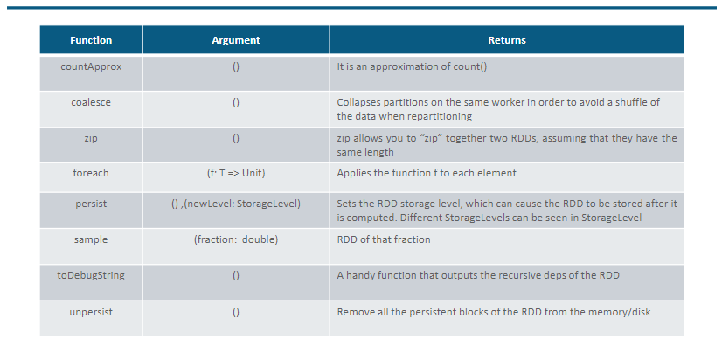
General RDD Functions

Slide 10
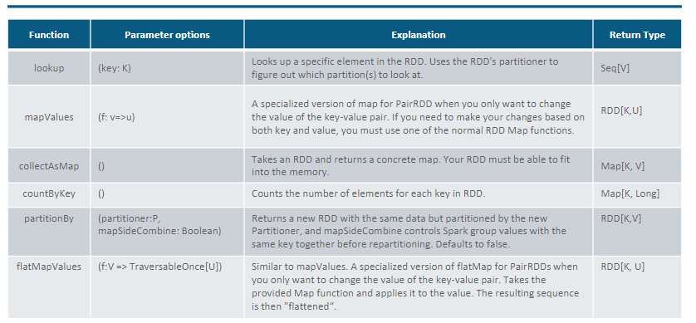
Other Pair RDD Functions

Slide 11
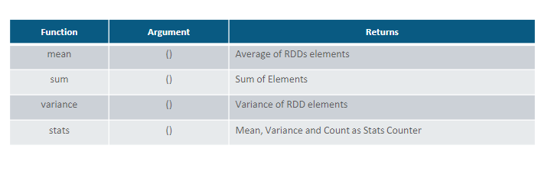
Double RDD Functions

Slide 12
Some things to remember
RDD is recomputed every time it is materialized. Hence you can cache RDD if it is accessed frequently.
In local mode, you just need to specify file location. In distributed mode, the file should be accessible all the nodes in the cluster
Operation should follow associative law and commutative law for reduceByKey operations.
Don’t collect() on large dataset
reduceByKey is better than groupByKey
repartition vs coalesce

Slide 13
Shared Variables
Broadcast
Persist
Cache
Accumulators

Slide 14
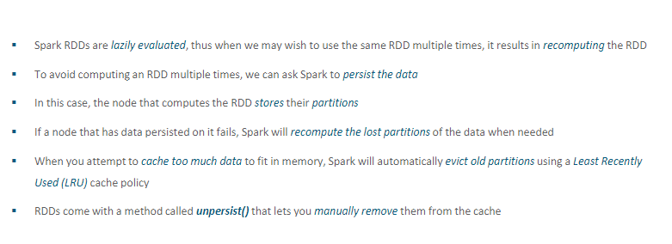
RDD Persistence

Slide 15
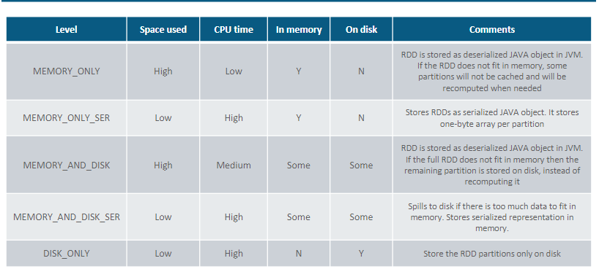
Persistence Level

Slide 16
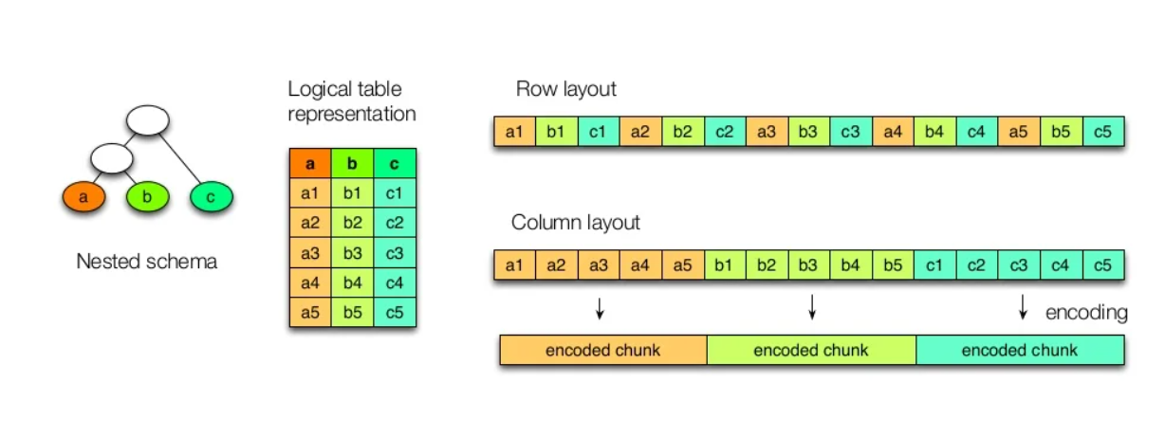
Columnar Storage

Slide 17
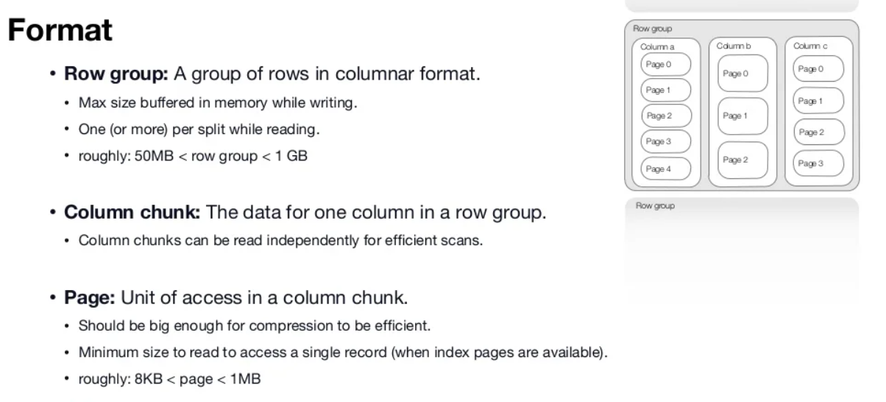

Slide 18
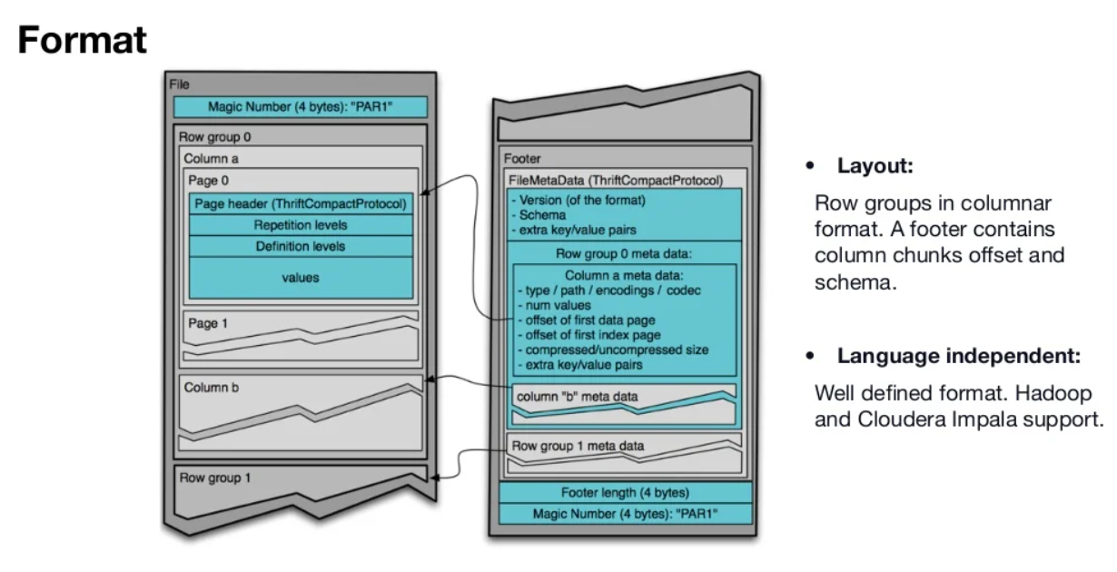

Slide 19
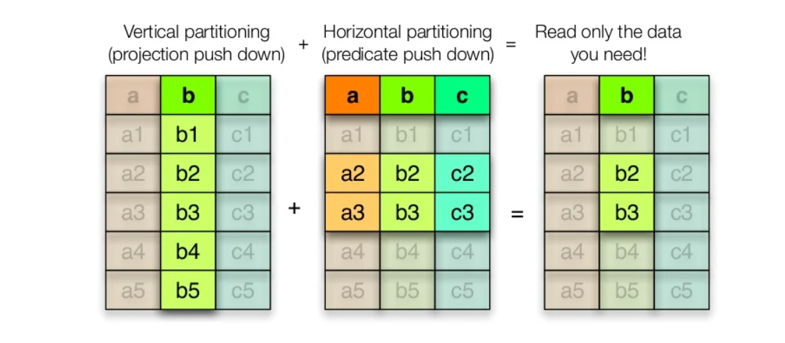
Statistics for filter and query optimization

